Slide 1
Sampled Sound Polyphonic Synthesizer
Amauri Lopez (CE) & Darrien Pinkman (CE)

Slide 2
Presentation Overview
Introduction
Projective Objectives
Project Specifications
Task List
Sound Modulation Theory
Implementation of Modulation Algorithm
Soundboard Hardware
Budget
Moving Forward
Questions

Slide 3
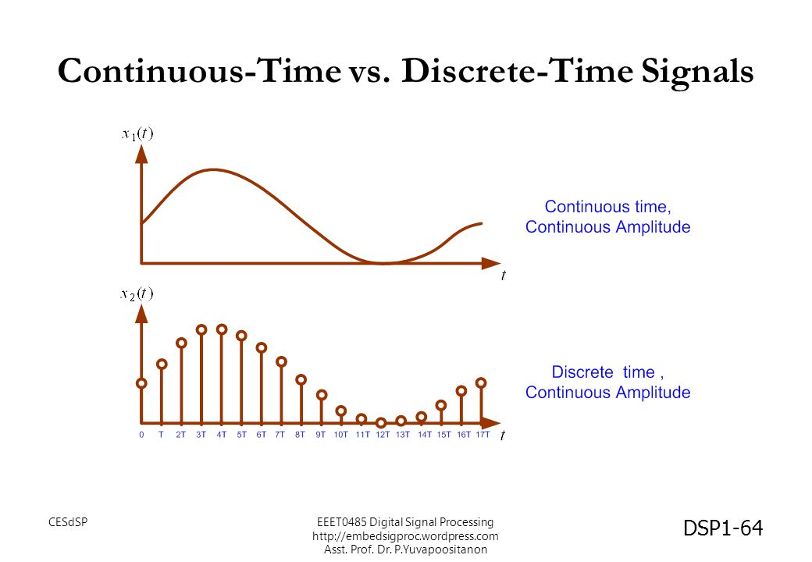
Introduction
What is a synthesizer?
Electronic music instrument that generates electric signals that are converted to sound through amplifiers, speakers, headphones, etc.
Sampled Sounds
Discrete-time signal
Fixed amount of samples within a finite time scale
What does polyphonic mean?
Capable of producing more than one note at a time

Slide 4
Project Objectives
Read user input from GPIO button presses
Defines user’s keyboard
Define a range of values representing the amount of new semitone shifts to create.
(Ex. [-2, -1, 0, 1])
Perform modulation on sample to generate appropriately adapted WAV files based on this range.
Each semitone is a factor of a note’s frequency defined by 2^(n/12) where n = the amount of semitones away from the original frequency.
Create a mapping between newly generated WAVs and user-input keyboard
Output the appropriate tone

Slide 5
Project Specifications
Two samples over two octaves
One per octave
24 Keys
Sampled Sounds
.WAV files
Polyphonic
3 tones at one time
5 Volt GPIO input voltage
10 K resistor on soundboard

Slide 6
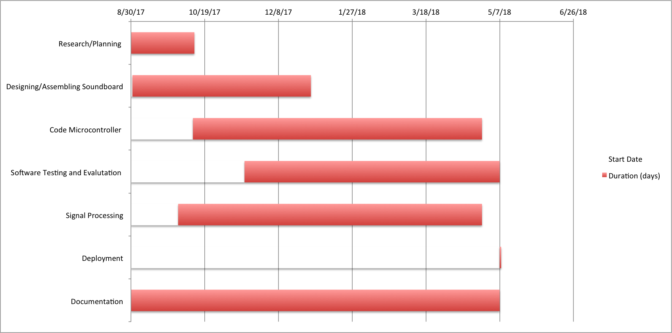
Schedule

Slide 7
Task List
Define Software Specifics
Establishing designs for Input/Output Systems
Made of hardware components such as the speaker for audio output, buttons of user input, resistances between buttons and input voltage, components for connection between GPIO and breadboard
Writing software used on the Raspberry Pi to accept GPIO input and output test sounds
Software Testing, Evaluation, and Refactoring by checking if test sounds play properly
Implementing the Phase Vocoder method to change the pitch of a sampled sound by a desired factor
Migration of Phase Vocoder to Raspberry Pi

Slide 8
Task 1: Defining Software Specifics
Software:
Using the Python 3 programming language: Includes helpful libraries to use
PyGame -> Open Source library for making multimedia applications.
Provides useful event-detection methods and Mixer module to play .WAV files
PySoundFile -> Audio library used to read and write sound files
NumPy -> Useful package for scientific computing
FFTs and IFFTs
Windowing functions

Slide 9
Task 2: Hardware designs for Raspberry Pi input/output system
SoundBoard Parts List:
4 Pin Tactile Push Buttons
Speaker
Breadboard
Raspberry Pi 3
GPIO Ribbon Cable
HDMI cable
Wires
Resistors

Slide 10
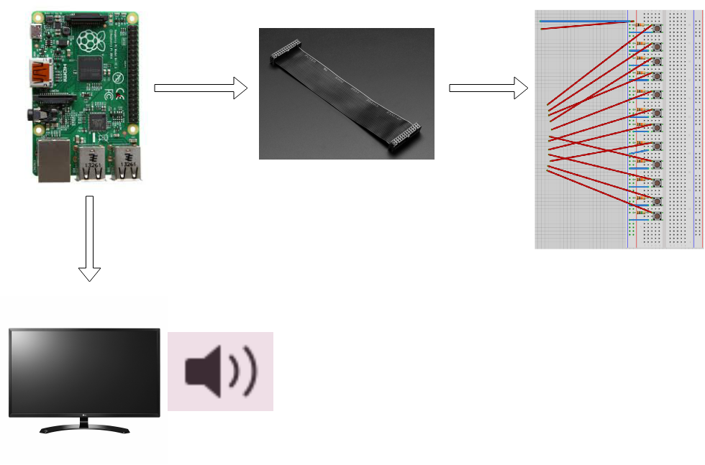
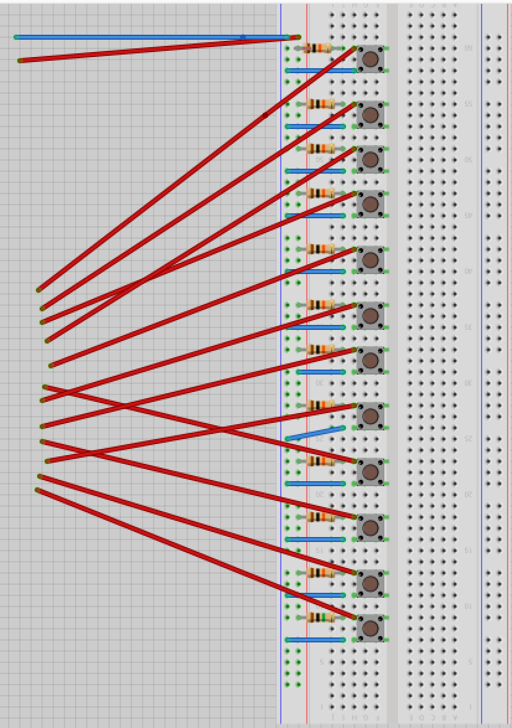

Slide 11
Task 3 and Task 4: Raspberry Pi Software (Setup GPIO input and output test sounds)
Wrote Python scripts to setup the input GPIO pins on the Raspberry Pi
Initialize each Pin as an input using SetMode GPIO.BCM (lets the Pi know we are using the outer labels of the GPIO Pin-Out diagram)
Set up PyGame Mixer Module
Allows for playing and loading sounds
Initialized Mixer with:
16-bit Sample Width
1024 Buffer Size
FPS = Sampling Rate : 44100 samples/sec
Continuously checked the state of each button press
output test sound

Slide 12
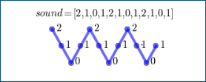
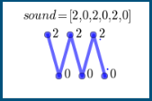
Theory of Modulation: Pitch Shifting
Pitch shifting can be realized by simply changing the framerate when playing the sound. But in this way, the length of the signal is also changed
Change the speed of playback(changes both pitch and duration)
To make this sound play 2x speed, remove every second value in the array
Increases pitch by 2x, produced sound of half duration

Slide 13
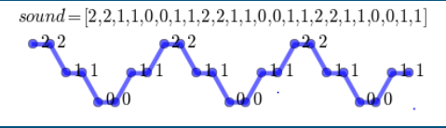
Theory of Modulation: Pitch Shifting
To make this sound play 2x slower, repeat each value in the array twice.
Produce a sound that is slower with a longer period, therefore lower pitched

Slide 14
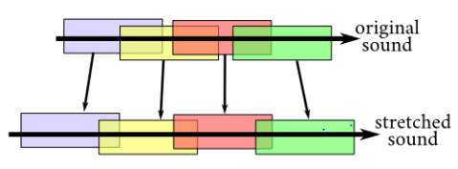
Theory of Modulation: The Phase Vocoder
Time Stretching: Change duration of sound while preserving its pitch.
Break the sound into overlapping bits
Rearrange these bits so that they overlap even more (if you want to shorten the sound)
Rearrange these bits so that they overlap less (if you want to lengthen the sound)
Pitch Shifting: Time stretch by a factor, then change the speed of playback by that same factor -> Result is a pitch shifted sound with original playback duration.

Slide 15
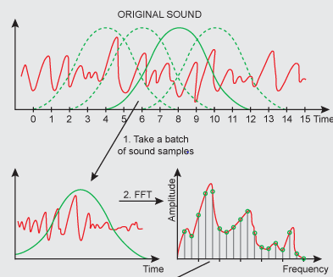
Theory of Modulation: The Phase Vocoder
To accomplish a Time Stretch:
Split the signal into overlapping bits
This was done by creating Hanning windows of size 2048 samples = chosen DFT_Size
With a hop_size = 256 samples
Compute the spectra of two consecutive windows, initialize placeholders for each spectra
Ex. spectra1 = fft(hanningWindow * wav_data[0: DFT_Size] spectra2 = fft(hanningWindow * wav_data[hop_size: DFT_size + hop_size]

Slide 16
Theory of Modulation: The Phase Vocoder
Calculate the phase difference between the two neighboring frequency bins and add it to a new phase array
When changing the overlap, you may experience some discontinuities in phase upon reconstruction.
Look at relative shifts in phase to determine how to realign these bins at the boundaries.
Normalize the phase by bringing it back between values of -pi and pi

Slide 17
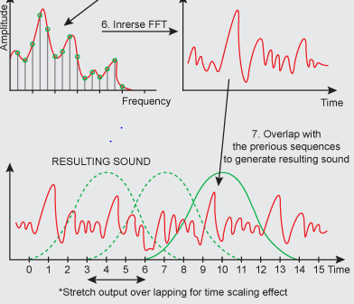
Theory of Modulation: The Phase Vocoder
Resynchronize the second bin onto the first:
Take the Inverse DFT of the magnitude of the second spectrum multiplied by the normalized phase difference, and bind it to the size of the hanning window
Provides a smooth transition between two neighboring windows
Move onto the next window and repeat until all bits have been realigned.
Increment the placeholder for spectra1 by hop_size*factor, spectra2 by hop_size
Write a new output wav_data and scale it to match the original amplitude of the signal.

Slide 18
Theory of Modulation: The Phase Vocoder
Once the Time Stretch is complete, you then change the speed of the sound by that same factor to accomplish the pitch shift.
Create an even-spaced array to hold the new wav_data
Spacing is determined by the Factor of the speed change.
Ex. If Factor = 2.33
Spaced array of [0, 2.33, 4.66, …]
Re-populates the wav_data vector for all values within it’s original length, to only values neighboring those defined in the spaced array.
The larger the factor, the more spaced the “Spaced array” will be
More space in the Space array means less values withheld in the wav_data array = increased pitch and vice versa.

Slide 19
Task 5: Implementation of Phase Vocoder Method
Open up a PyGame input interface to allow the user to input the desired buttons to be used as their keyboard - mark these in a text file.
Input wav data into Phase Vocoder with a range of shifts.
The sound is time-stretched by a factor 2^(n/12) for the first shift
The sound is speed changed by the same factor for the first shift
The output wav_data is then written to a new WAV file held in a Samples folder
Repeat for the next shift
Take WAV files present in newly created Samples folder and pair each WAV with a corresponding key in the earlier text file
Constantly check if any of these specified keys are pressed and output their corresponding pitch-shifted sound.

Slide 20
Task 6: Migration of Phase Vocoder Implementation to Raspberry Pi
All event-detection methods used in our testing (events for KEYDOWN and KEYUP events on PC) will be changed to check a state of a GPIO pin instead
All File locations of available samples must be changed to new locations on the Raspberry Pi
All other set-up (user keyboard text files and mixer configuration files) should not have to be changed

Slide 21
Hardware Demo: PC Keyboard Version

Slide 22
Budget
Raspberry Pi 3 Model B: $35.00
5V 2.4A Power Supply with 20AWG MicroUSB Cable: $7.50
HDMI cable: $29.99
Breadboard: $32.00
4 Pin Tactile Push Buttons: $.28 each (x24)
Speaker (TBD) Some options:
PCB Mount: $1.95
SparkFun Mount: $1.90
GPIO Ribbon Cable: $2.95
Miscellaneous: $50.00

Slide 23
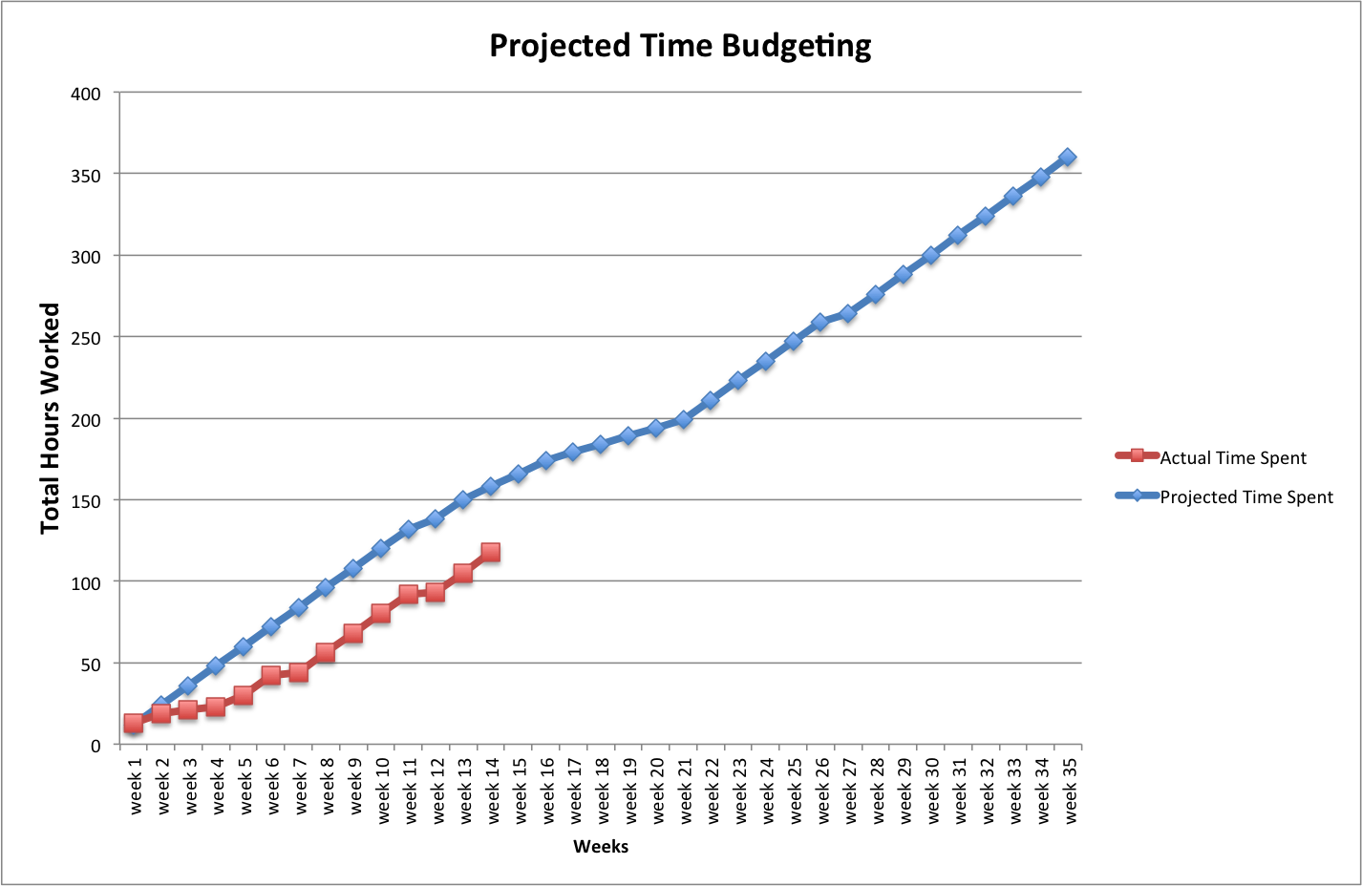

Slide 24
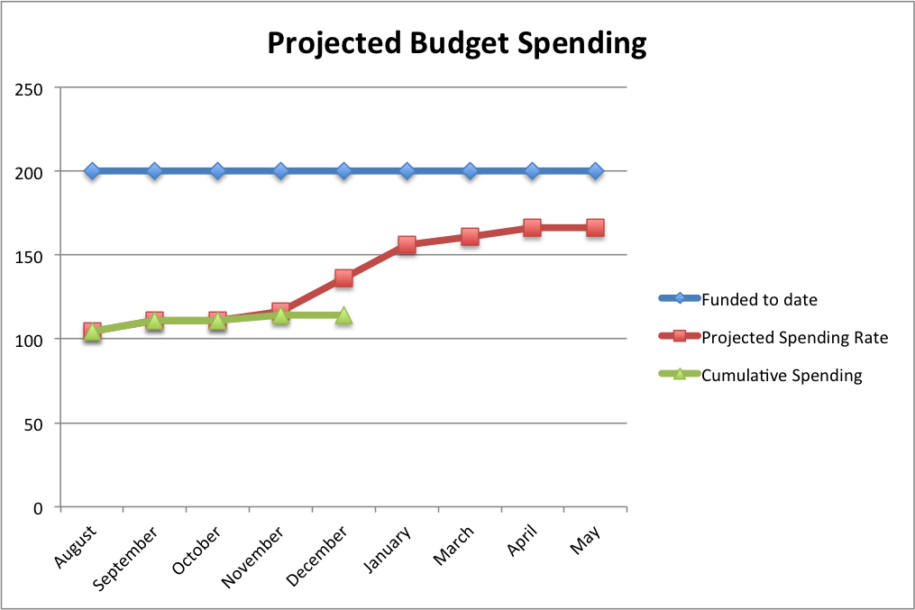

Slide 25
Conclusion
Midway point of creating a sampled sound synthesizer that is polyphonic in nature
Using Digital Signal Processing to enable us to take in a sampled sound and span that sound over 12 semitones
Sound output to a monitor via HDMI currently
Soon to be speaker of our choice

Slide 26
Moving Forward
Continue to clean up sound quality within the algorithm
Finishing the migration and integration of the Vocoder Method to the Raspberry Pi
Translating creation of keyboard on PC into GPIO button presses
Generating sound output through speaker of choice
GPIO pin (push button) dedicated for each set of 12 keys
Cycle through a list of sampled sounds
Synthesizer Casing
Aesthetics

Slide 27
Questions?

